Slide 1


Airline Performance Dashboard
White Cloud Airlines
Data Analyst Portfolio Project
Prepared by : Pratima Sahu
Tools: Power BI

Slide 2
Project Objective
Analyze airline flight performance and provide insights for management.
The dashboard focuses on:
- Revenue performance
- Flight delays
- Passenger load
- Route profitability

Slide 3
Key Performance Indicators (KPIs)
Total Revenue: $12.46M
Average Delay: 89.7 minutes
Passenger Load: 191 passengers per flight
Most Profitable Route: DFW–SEA ($1.6M)

Slide 4
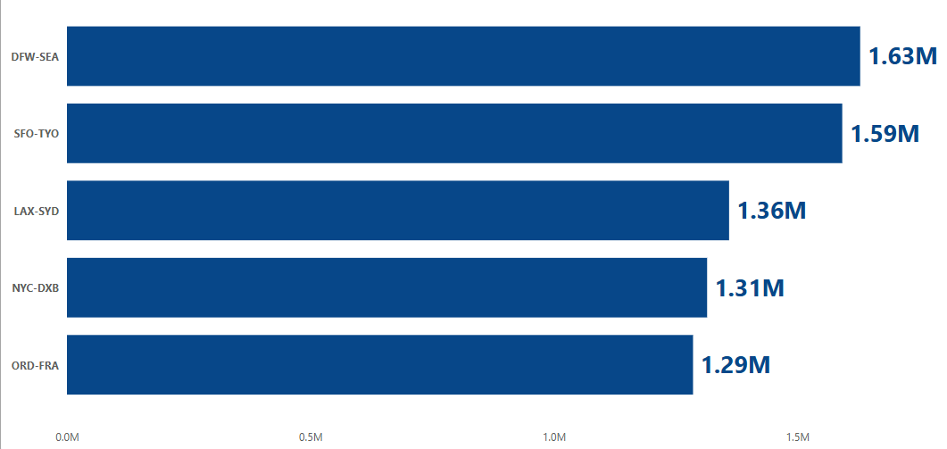
Route Revenue Analysis
This visual highlights the top revenue-generating routes.
DFW–SEA and SFO–TYO generate the highest revenue.
Helps identify high-demand flight routes.

Slide 5
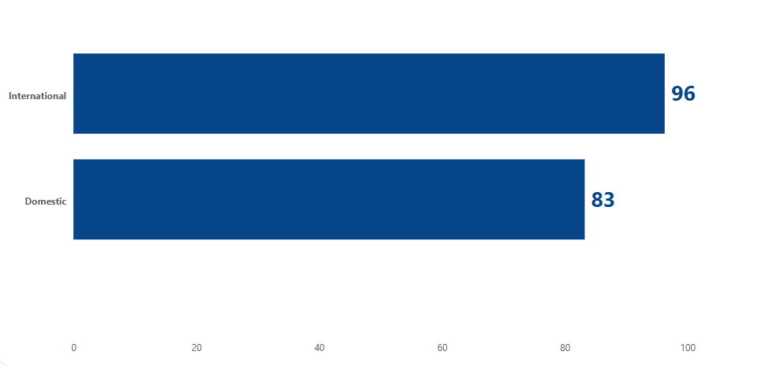
Operational Insights
Comparison between Domestic and International delays.
International flights experience slightly higher delays.

Slide 6
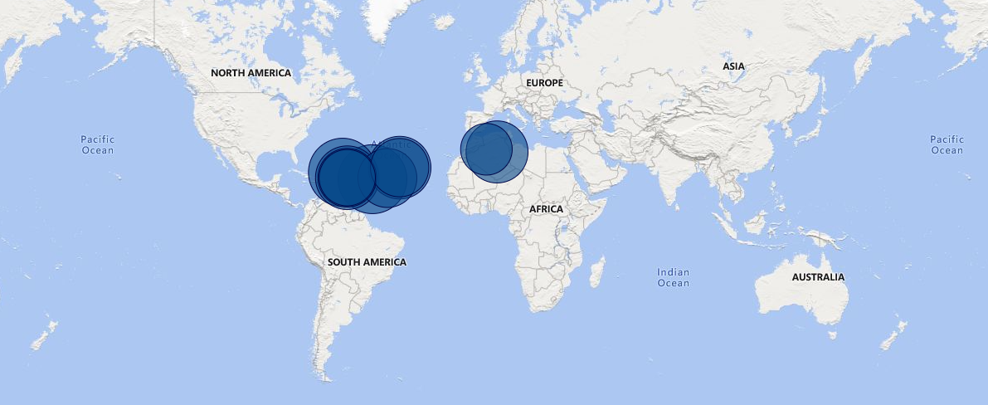
Geographical Route Performance
Map visual shows global route performance.
Bubble size represents revenue generated by each route.
Helps identify strong markets geographically.

Slide 7
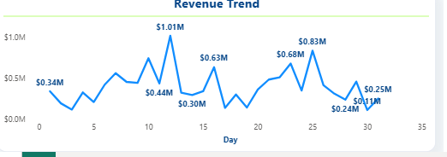
Daily revenue trend
This trend suggests that travel demand fluctuates throughout the month, with strong peaks in the middle and late parts of the month.

Slide 8
Business Insights
DFW–SEA is the most profitable route.
International flights show higher delays.
Revenue peaks mid-month indicating higher travel demand.
Management can focus on optimizing high-performing routes.

Slide 9
Thank You

